Slide 1
The presentation of search algorithm

Slide 2
Brief introduction

Slide 3
Brief introduction
The search algorithm is a method of using the high performance of the computer to purposefully enumerate part or all of the possible situations in the solution space of a problem, so as to solve the problem.
Search Algorithm
Blind Search
Heuristic Search
Local Search
DFS
BFS
Best-first Search
A-star Search
Hill climbing
Simulated annealing
For a better demonstration, this ppt sets the scene as Brave the Maze Game, that is, solve the maze path finding problem through search algorithm

Slide 4
Blind Search

Slide 5
Defination
Blind Search
Depth First Search
Breadth First Search
Non-heuristic search
A non-information search, that is, the search is carried out according to a predetermined search strategy during the search process, and the characteristics of the problem itself are not considered
The brute force method learned in algorithm class

Slide 6
DFS INTRODUCTION
Stone
Draw
Can be used in the retrospective method
In each state, try to the current state you can go to until you reach the goal
Time complexity: exponential
Stone
Scissors
Win
Cloth
Fail
Stone
Fail
def dfs(x:int,y:int):
if x==endX and y==endY:
pass
if map.map[x][y+1]==0 and visited[x][y+1]==0:#right
visited[x][y+1]=1
dfs(x,y+1)
visited[x][y+1]=0
if map.map[x][y-1]==0 and visited[x][y-1]==0:#left
visited[x][y-1]=1
dfs(x,y-1)
visited[x][y-1]=0
Start
Scissors
Scissors
Draw
Cloth
Win
Stone
Win
Cloth
Scissors
Fail
Cloth
Draw

Slide 7
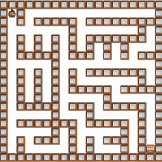
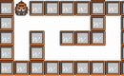
DFS Presentation
At each intersection, operate the branches you can go to in turn. If a branch cannot continue, go back to the current state

Slide 8
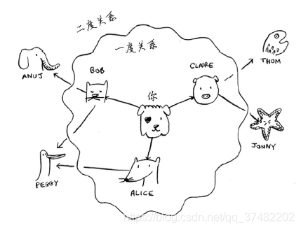
BFS INTRODUCTION
The first generated node is expanded first
Put all possible situations into the queue at each step to ensure that there are no omissions
Each node has its predecessor node, which is the previous node of the node
Used to find the closest path in the network of relationships

Slide 9
BFS PRESENTATION——Path Expansion
def bfs():
dx, dy =[1,0,-1,0], [0,1,0,-1]
queue=deque()
queue.append([x,y])
while True:
curr=queue.popleft()
find=False
for i in range(4):
nx,ny=curr[0]+dx[i],curr[1]+dy[i]
if map.map[nx][ny]==0:
pre[nx][ny]=curr
checkBfs[nx][ny]=1
queue.append([nx,ny])
if nx==endX and ny==endY:
break
Search for the target point through breadth first search
Through the first-come, first-expanded approach

Slide 10
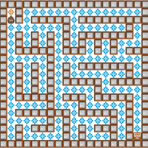
BFS PRESENTATION——Backtracking path
stack,curr = [],[endX,endY]
while True:
stack.append(curr)
if curr[0] == startX and curr[1] == startY:
break
prev = pre[curr[0]][curr[1]]
curr = prev
while stack:
curr = stack.pop()
Find the feasible path by searching for the predecessor node

Slide 11
Comparison
 | DFS | BFS
Design method | Recursive and non-recursive | Usually non-recursive
Data Structure | Stack | Queue
Expand Method | Nodes with small depth may eventually be expanded | Nodes with small depth are expanded first
Storage | The path of the current search tree | All paths expanded
Presentation

Slide 12
Heuristic Search

Slide 13
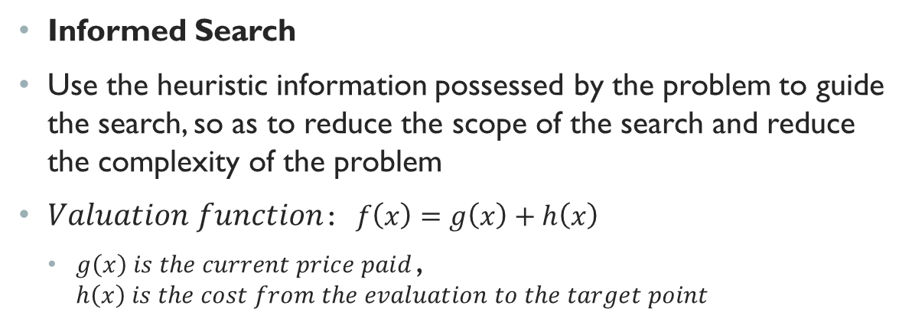
defination
Heuristic Search
Best-first Search
A-Star Search
Informed Search
Use the heuristic information possessed by the problem to guide the search, so as to reduce the scope of the search and reduce the complexity of the problem
$Valuation function：f\left(x\right)=g\left(x\right)+h\left(x\right)$
$g\left(x\right) is the current price paid$， $h\left(x\right) is the cost from the evaluation to the target point$

Slide 14
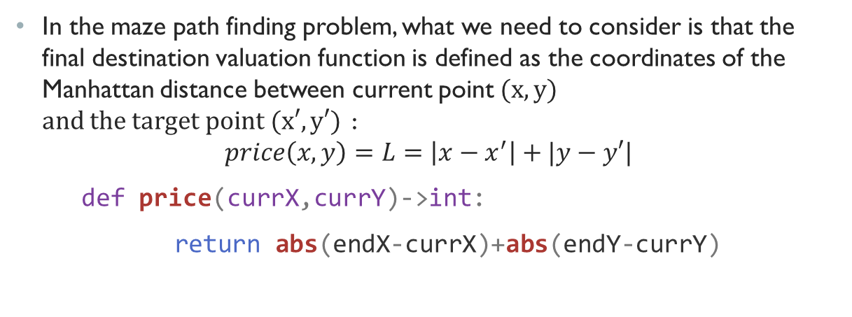
Best-first search introduction
Heuristic function ：f(x)=h(x)
Only care that the next state in the current state has the lowest heuristic
Similar to the greedy algorithm in algorithm class
In the maze path finding problem, what we need to consider is that the final destination valuation function is defined as the coordinates of the Manhattan distance between current point$(x,y)$ $and the target point (x′,y′)$ ：
$$price\left(x,y\right)=L=\left|x−x^{′}\right|+|y−y′|$$
def price(currX,currY)->int:
return abs(endX-currX)+abs(endY-currY)

Slide 15
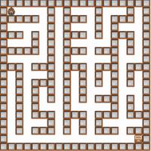
Best-first search presentation
Similar to breadth first search, it also finds the target node first and then backtracks to find the path
The use of heuristic function greatly improves the search efficiency
The design of a good heuristic function h(x) plays an extremely important role in the performance of the heuristic algorithm
while openList:
openList.sort(key=lambda x:(x[2],abs(x[1]-x[0])))
curr=openList.pop(0)[:-1]
Code: First expand the node with the smallest heuristic value each time

Slide 16
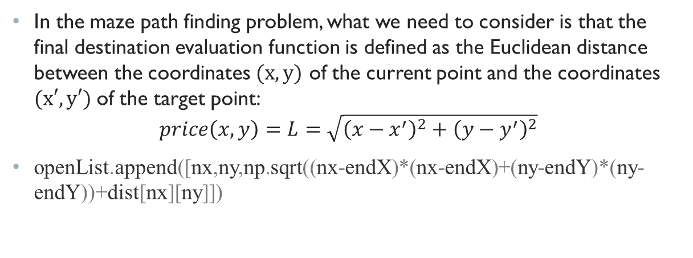
A-Star Search
Heuristic function ：f(x)=g(x)+h(x)
Consider both the cost that has been consumed and the cost that is expected to be consumed
Can avoid falling into local optimal solution to a certain extent
In the maze path finding problem, what we need to consider is that the final destination evaluation function is defined as the Euclidean distance between the coordinates $(x,y)$ of the current point and the coordinates $(x′,y′)$of the target point:
$$price\left(x,y\right)=L=\sqrt{{\left(x−x^{′}\right)}^{2}+{\left(y−y^{′}\right)}^{2}}$$
openList.append([nx,ny,np.sqrt((nx-endX)*(nx-endX)+(ny-endY)*(ny-endY))+dist[nx][ny]])

Slide 17
Comparison of non-heuristic and heuristic
 | Breadth-first Search | Best-first Search | A-Star Search
Heuristic function | Non-heuristic search | f(x)=h(x) | f(x)=g(x)+h(x)
Expansion strategy | Sequential expansion | Greedy algorithm, only considers future costs | Consider current and future costs
Effectiveness | Relatively low | There are improvements on BFS | There are improvements on BFS
Prensentation

Slide 18
Local Search

Slide 19
defination
Local Search
Hill climbing
Simulated annealing
Genetic algorithm
Conventional problem-solving methods cannot solve complex problems such as NP
Consider seeking approximate solutions
A good understanding can usually be found in a large or infinite (continuous) state space where systematic algorithms are not applicable

Slide 20
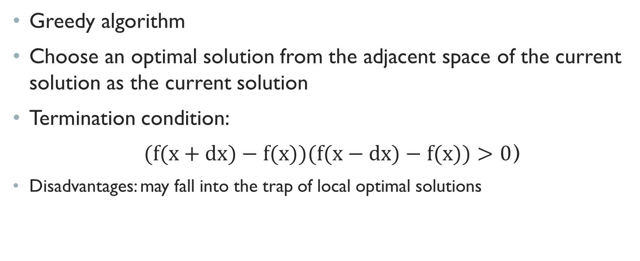
Hill climbing
Greedy algorithm
Choose an optimal solution from the adjacent space of the current solution as the current solution
Termination condition:
$(f(x+dx)−f(x))(f(x−dx)−f(x))>0$）
Disadvantages: may fall into the trap of local optimal solutions

Slide 21
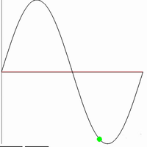
Hill climbing presentation
Solve for the maximum value of y=sinx
Randomly pick a starting point
Judgment of the size of the loop and surrounding points
Greater than both ends, exit the loop
def hillClimbing(f,a:float,b:float,rxMax=0.01): hillX=random.random()*(b-a)+a
rx=rxMax*random.random()
while (f(hillX)<f(hillX+rx) and f(hillX)>f(hillX-rx)):
if f(hillX)<f(hillX+rx):
hillX+=rx
else:
hillX-=rx
rx=rxMax*random.random()#update

Slide 22
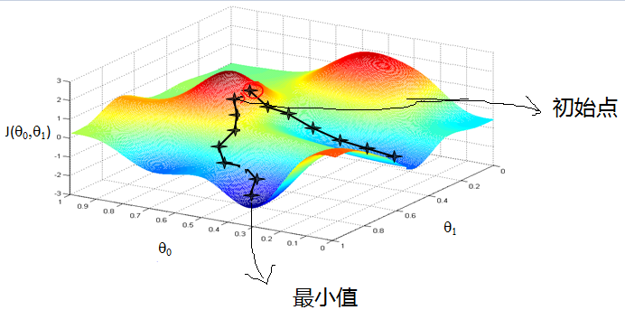
Gradient Descent Optimization
在机器学习算法中，在最小化损失函数时，可以通过梯度下降法来一步步的迭代求解，得到最小化的损失函数，和模型参数值。反过来，需要求解损失函数的最大值，这时就需要用梯度上升法来迭代了。
梯度下降法和梯度上升法是可以互相转化的。比如我们需要求解损失函数f(θ)的最小值，这时我们需要用梯度下降法来迭代求解。但是实际上，我们可以反过来求解损失函数 -f(θ)的最大值，这时梯度上升法就派上用场了。
梯度下降的一个直观的解释:比如我们在一座大山上的某处位置，由于我们不知道怎么下山，于是决定走一步算一步，也就是在每走到一个位置的时候，求解当前位置的梯度，沿着梯度的负方向，也就是当前最陡峭的位置向下走一步，然后继续求解当前位置梯度，向这一步所在位置沿着最陡峭最易下山的位置走一步。这样一步步的走下去，一直走到觉得我们已经到了山脚。当然这样走下去，有可能我们不能走到山脚，而是到了某一个局部的山峰低处。
梯度下降不一定能够找到全局的最优解，有可能是一个局部最优解。当然，如果损失函数是凸函数，梯度下降法得到的解就一定是全局最优解

Slide 23
Simulated annealing
Improvement of climbing method
Accept a solution that is worse than the current solution with a certain probability, but the probability of accepting the poor solution decreases as the number of iterations increases
Can avoid falling into local optimal solution to a certain extent
def simulatedAnaling(s0,E,kmax,emax,neighbor):
s=s0
e=E(s) #初始状态s0,能量E(s0)
k=0#评估次数k
while k < kmax and e > emax:#评估次数k还不到kmax且能量e不够低
sn=neighbor(s)#随机选取临近状态sn
en=E(sn)#sn的能量值为en
if en < sn or random.random()/k > 0.1: #最优解或者概率接受差解
s,e=sn,en
k+=1
return s#返回状态s

Slide 24
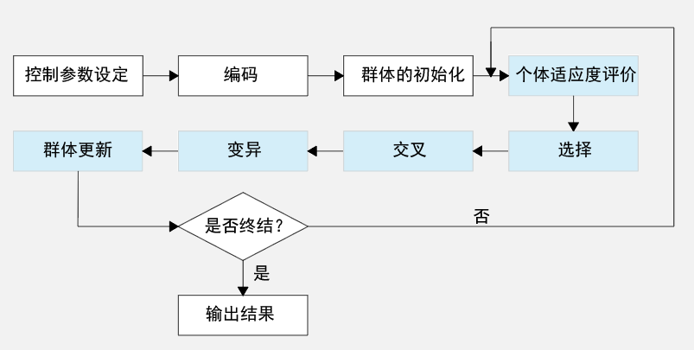
Genetic algorithm
Derived from biological genetics and the natural laws of survival of the fittest
There are no special requirements for the search space, and the scope of application is wider
Iterate from one set of solutions to another set of connected solutions, which reduces the possibility of falling into a local optimal solution

Slide 25
The development of genetic algorithms
 | Traditional genetic algorithm | Adaptive genetic algorithm | Improved adaptive genetic algorithm
Set up | Relatively fixed parameters | The parameters change with the number of iterations | Redefine and adopt optimal preservation strategy
Features | Easy to fall into local optimal solution | To a certain extent, it solves the problem of falling into a local optimal solution | It better solves the problem of falling into the local optimal solution, and has a wide range of applications

Slide 26
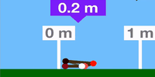
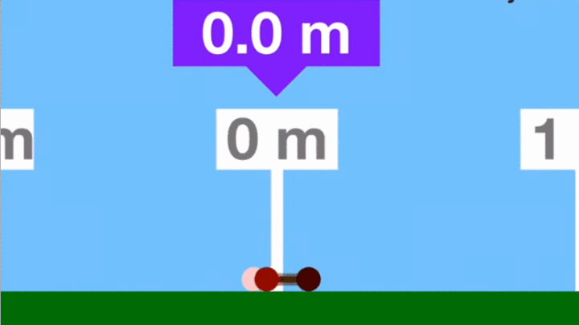
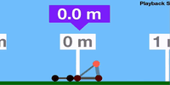
Genetic algorithm presentation
Initialization of the group: randomly generate 100 initial individuals

Slide 27
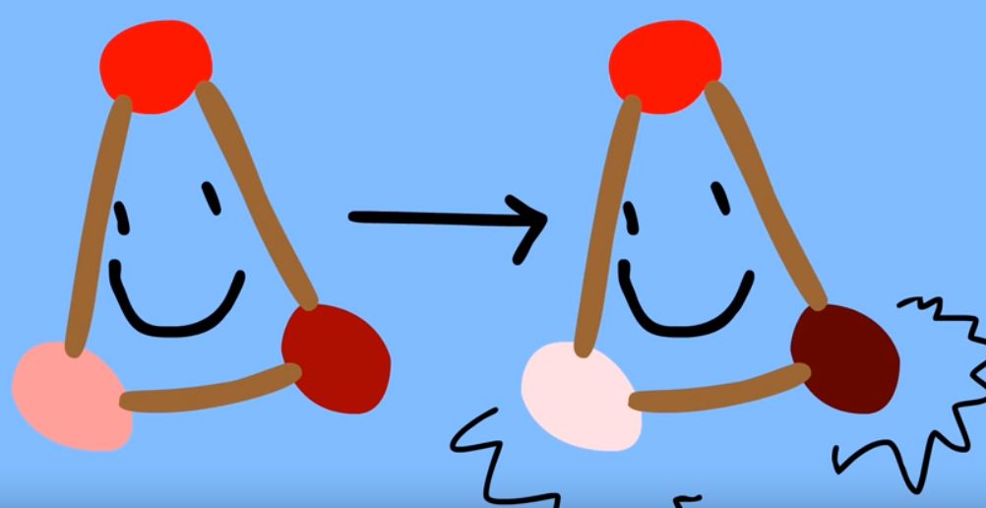
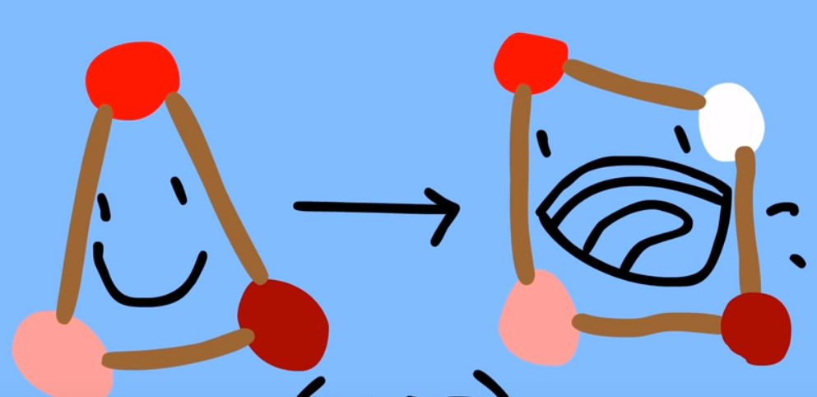
Genetic algorithm presentation
Crossover and mutation of populations: producing offspring

Slide 28
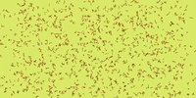
Genetic algorithm presentation
Group selection: weed out slow individuals

Slide 29
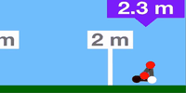
Genetic algorithm presentation
Multiple iterations: produce the final good individual

Slide 30
summary

Slide 31
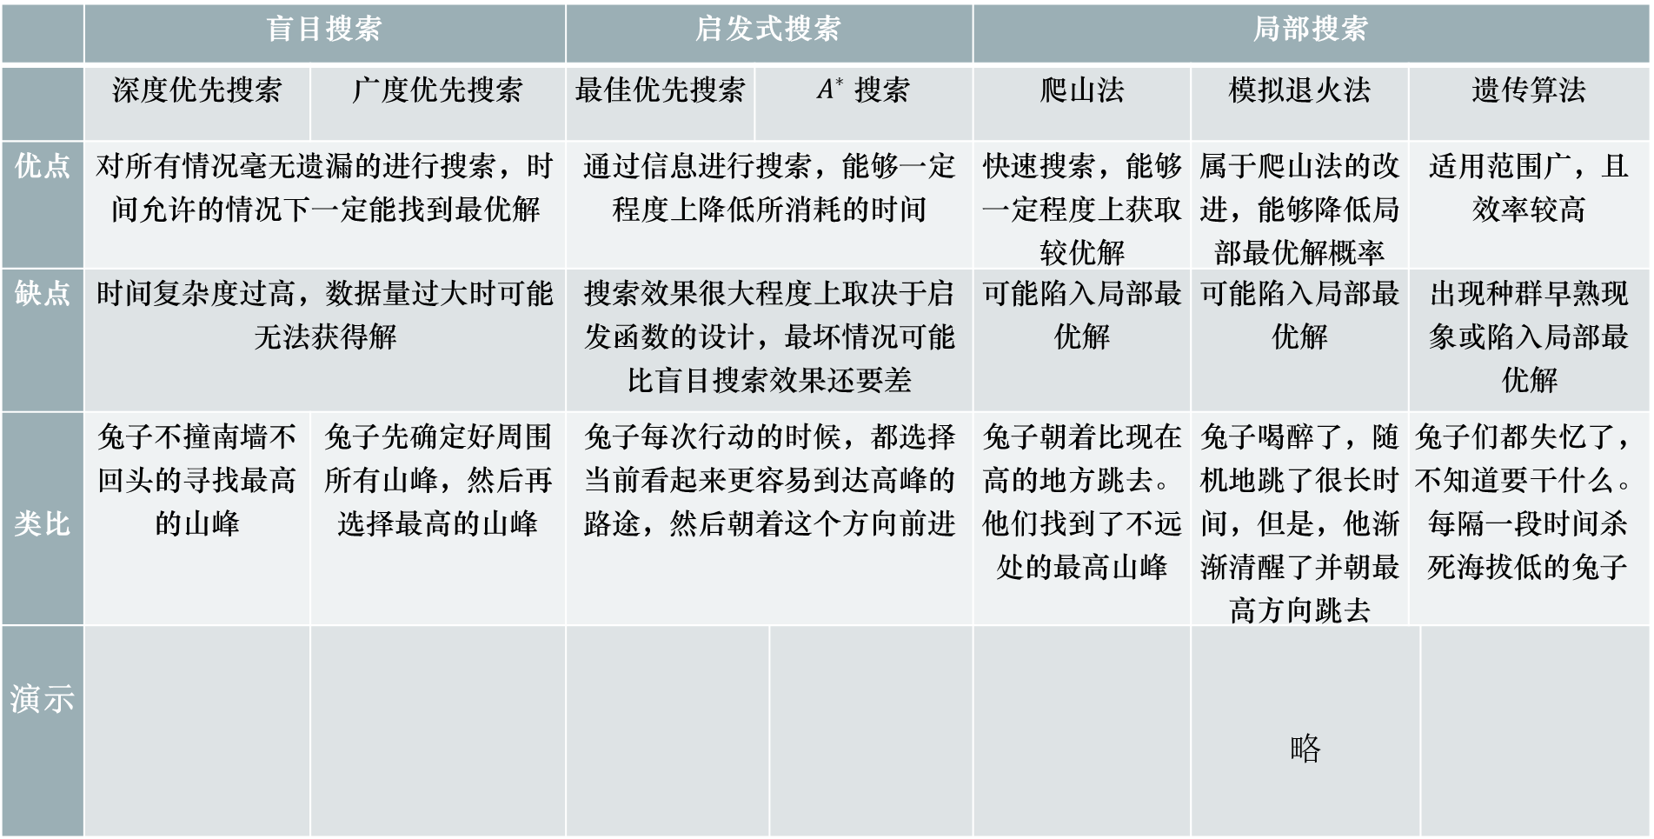
搜索算法对比
 | 盲目搜索 |  | 启发式搜索 |  |  | 局部搜索
 | 深度优先搜索 | 广度优先搜索 | 最佳优先搜索 | $A^{∗}$ 搜索 |  | 爬山法 | 模拟退火法 | 遗传算法
优点 | 对所有情况毫无遗漏的进行搜索，时间允许的情况下一定能找到最优解 |  | 通过信息进行搜索，能够一定程度上降低所消耗的时间 |  |  | 快速搜索，能够一定程度上获取较优解 | 属于爬山法的改进，能够降低局部最优解概率 | 适用范围广，且效率较高
缺点 | 时间复杂度过高，数据量过大时可能无法获得解 |  | 搜索效果很大程度上取决于启发函数的设计，最坏情况可能比盲目搜索效果还要差 |  |  | 可能陷入局部最优解 | 可能陷入局部最优解 | 出现种群早熟现象或陷入局部最优解
类比 | 兔子不撞南墙不回头的寻找最高的山峰 | 兔子先确定好周围所有山峰，然后再选择最高的山峰 | 兔子每次行动的时候，都选择当前看起来更容易到达高峰的路途，然后朝着这个方向前进 |  |  | 兔子朝着比现在高的地方跳去。他们找到了不远处的最高山峰 | 兔子喝醉了，随机地跳了很长时间，但是，他渐渐清醒了并朝最高方向跳去 | 兔子们都失忆了，不知道要干什么。每隔一段时间杀死海拔低的兔子
演示 |  |  |  |  |  |  | 略

Slide 32
谢谢！
注：演示动画来源于手写的py代码（使用pygame库），可在下方链接下载获取：
https://github.com/wangwangwang23333/Introduction-to-Artificial-Intelligence

Slide 33
Simulated annealing
Improvement of climbing method
Accept a solution that is worse than the current solution with a certain probability, but the probability of accepting the poor solution decreases as the number of iterations increases
Can avoid falling into local optimal solution to a certain extent
def simulatedAnaling(s0,E,kmax,emax,neighbor):
s=s0
e=E(s) #初始状态s0,能量E(s0)
k=0#评估次数k
while k < kmax and e > emax:#评估次数k还不到kmax且能量e不够低
sn=neighbor(s)#随机选取临近状态sn
en=E(sn)#sn的能量值为en
if en < sn or random.random()/k > 0.1: #最优解或者概率接受差解
s,e=sn,en
k+=1
return s#返回状态s

Slide 34
模拟退火算法
固体的退火过程指的是将固体加热至足够高的温度，再使其慢慢冷却的过程。在加热过程中，原本有序排列的内部粒子开始无序运动，此时固体的内能不断增大；而在降温过程中，粒子的排列又逐渐有序。
而物体系统总是趋向于保持能量最低的状态，理论上讲，在退火过程的降温过程中，如果降温过程足够的慢，可将每一时刻离散化，那么每一个温度下的固体都可能达到允许范围内的最小内能状态，而如何寻找该温度及状态即为模拟退火算法的核心问题。

